Slide 1
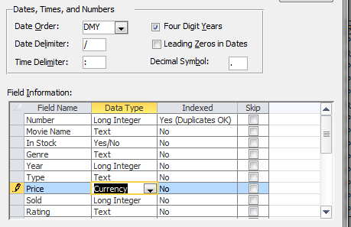
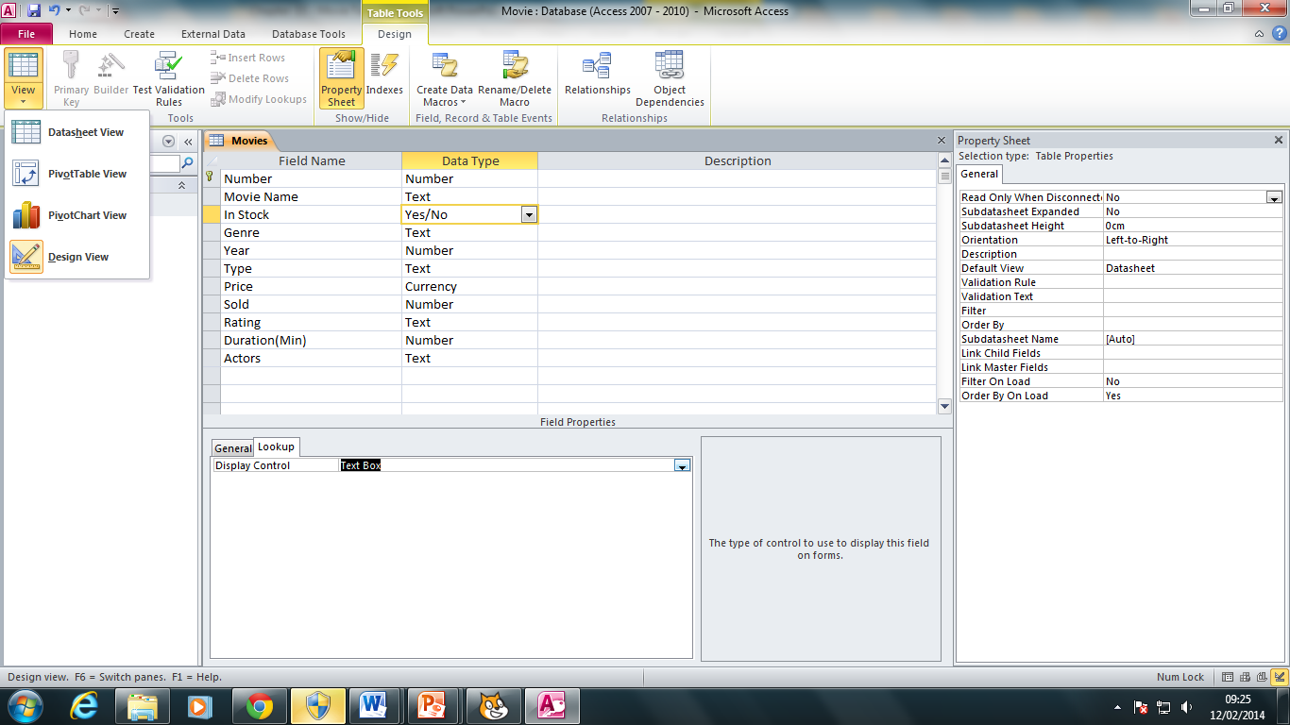
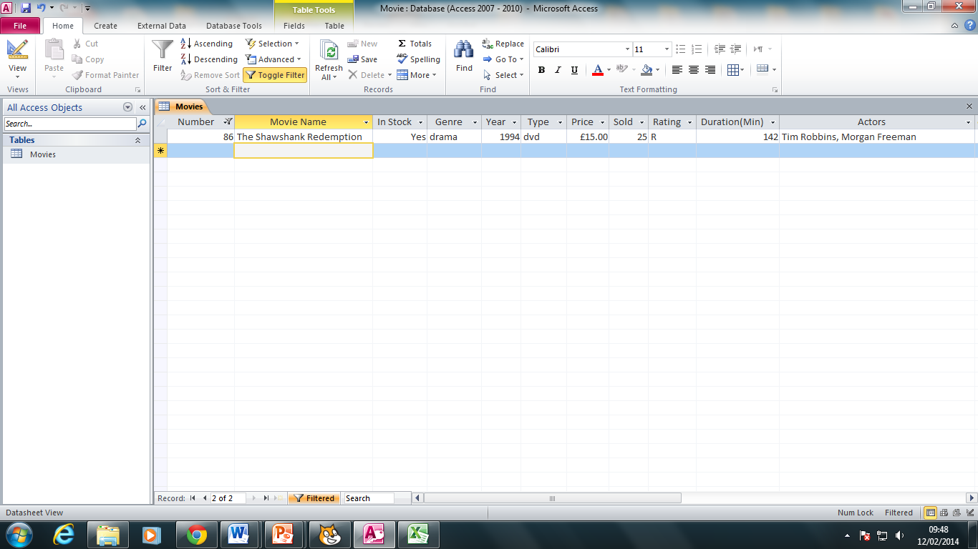
Using a suitable database package (Access), import the file movie.CSV (Data Format – Day/Month/Year) Remember to change the field types when importing the CSV file to avoid import errors. Assign the following data types to the fields: Each movie will have a unique number. Set the number as the primary key.
2) Please add the following records (movies) to your database - Stock – Yes, Price - £15, Type - DVD The Shawshank Redemption: (Drama, 1994, Sold – 25, Rating – R, Duration – 142min, Actors - Tim Robbins Morgan Freeman) Gladiator: (Drama, 2000, sold – 35, Rating – R, Duration 155min, Actors - Russell Crowe, Joaquin Phoenix) Green Mile: (Drama, 1999, sold – 27, Rating – R, Duration 189min, Actors - Tom Hanks Michael Clarke Duncan)
The “In stock” field needs to be a Boolean. The format needs to be set as “Text box”.

